Slide 1
PRODUCT CUSTOMER SEGMENTATION AND CLUSTERING

Slide 2
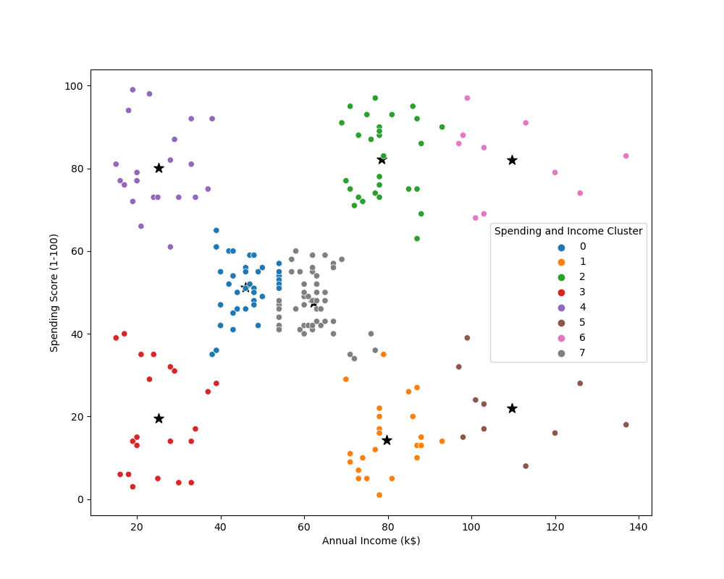
CLUSTERING BIVARIATE
This scatter plot segments customers based on annual income and spending behavior, revealing distinct shopping patterns.
High-income, high-spending customers (green cluster) are ideal targets for premium products, while low-income, high-spending shoppers (purple cluster) may respond well to discounts and promotions.
The low-spending, high-income group (brown cluster) presents an opportunity to increase engagement through loyalty programs.

Slide 3
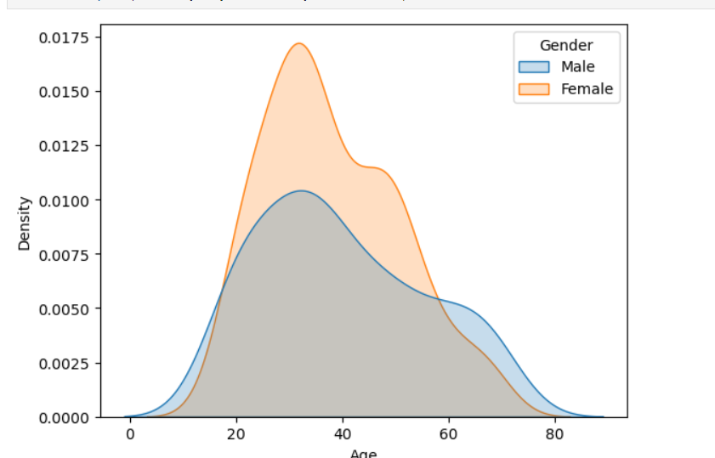
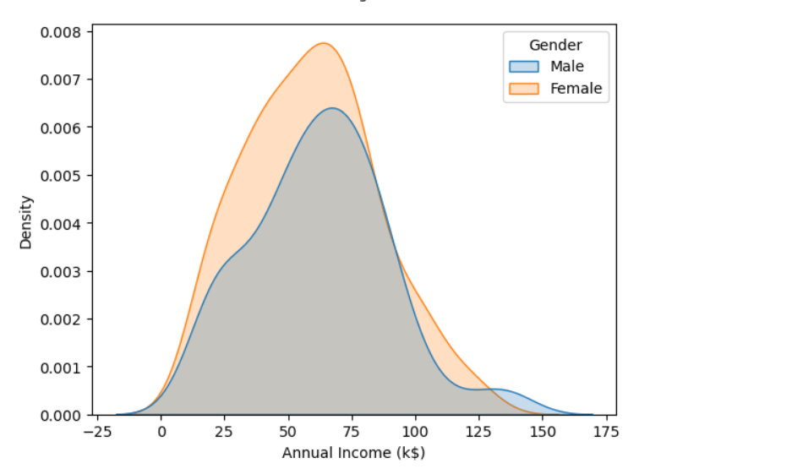
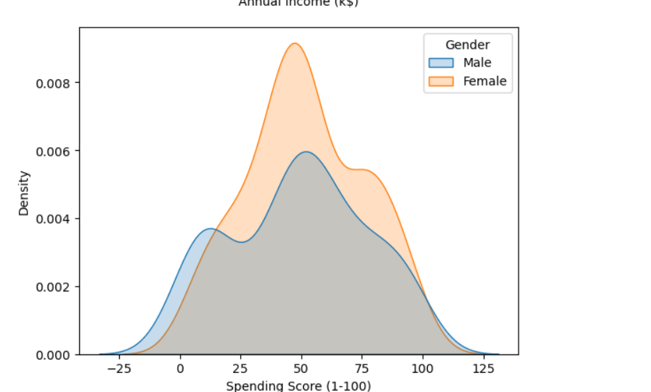
This plot compares the age distribution of male and female customers. The peak density for females occurs at a younger age range (around 30-40), indicating a higher concentration of younger female customers. Males have a broader age distribution, with a more even spread across different age groups.
The male income distribution appears to be bimodal, meaning it has two distinct peaks. One peak is around $50,000 - $75,000, and the other is around $100,000 - $125,000. The female income distribution seems to be unimodal, with a single peak around $50,000 - $75,000.
Male spending scores show two distinct groups: high spenders and low spenders, while female spending is more concentrated around a moderate range. This suggests targeted marketing strategies could be effective, with different approaches for each male spending segment and a more general approach for female customers.

